Slide 1
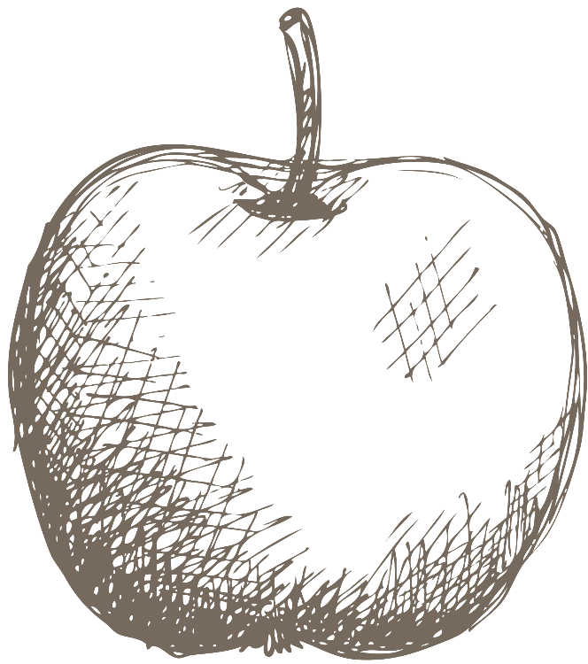
Aesthetic Quality Assessment
Mentored by- Prof. Sarp Akcay

Slide 2
Introduction
The aesthetic quality of images is a crucial factor influencing user engagement on social media platforms like Instagram. For users aiming to establish a business account focused on food-related content, understanding and improving the aesthetic appeal of their posts can significantly enhance their online presence and engagement.
This literature review explores various methodologies and technologies that contribute to the development of an automated aesthetic quality assessment system, particularly for food content.

Slide 3
Idea
Bayesian Modelling
Machine Learning Integration
Gaussian Processes and Bayesian Neural Networks estimate uncertainty in aesthetic scores, crucial for subjective judgments.
Regression models and ensemble methods combine deep learning and Bayesian scores for robust predictions.
02
04
01
03
05
Deep Learning with CNNs
Monte Carlo Simulations
Hashtags and Engagement Metrics
Deep learning models extract features crucial for aesthetic assessment, enhancing the system's capability.
Estimating aesthetic score distributions enhances robustness and reliability.
Comparative analysis of general & aesthetic-related hashtags offers insights into user engagement & perceived aesthetic quality.

Slide 4
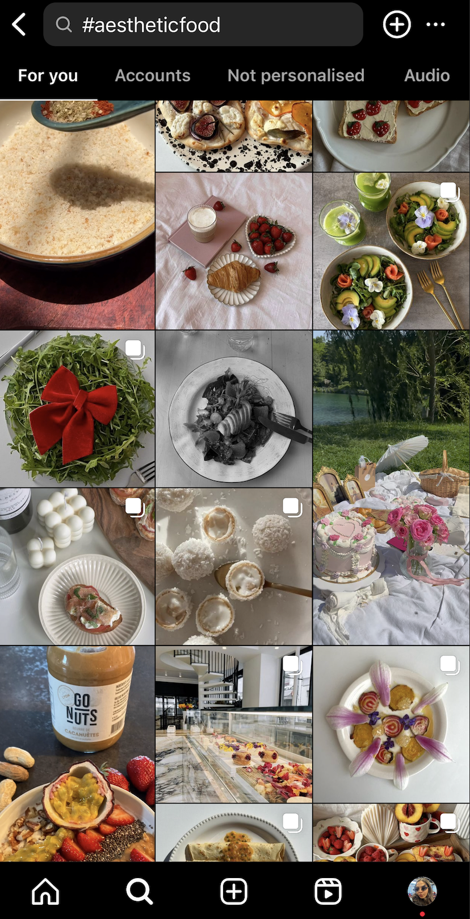
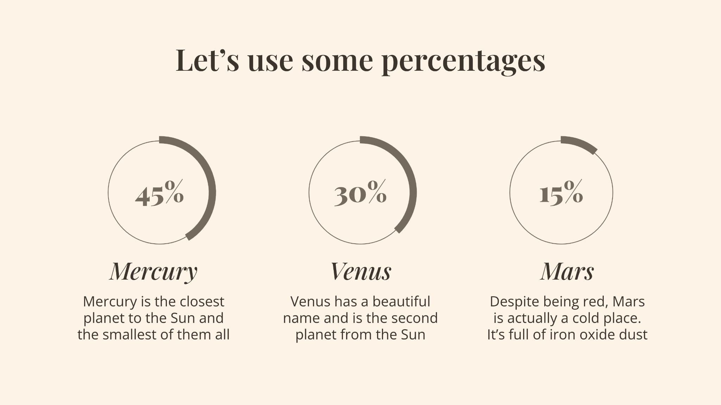
Practical use
In the realm of Instagram, the visual allure of posts holds immense significance, particularly for business accounts focused on food content. In a platform saturated with captivating visuals, the aesthetic appeal of food posts serves as the initial hook to attract users' attention amidst the sea of content.
This appeal extends beyond mere aesthetics; it also considers the users' engagement levels, including likes, comments, shares, and ultimately, the reach of the content to a broader audience. In essence, the visual presentation of food content acts as a powerful magnet, drawing in the masses and serving as the cornerstone for fostering meaningful interactions and connections with the audience.

Slide 5
Terms
Tone- 'Cool': 1, 'Warm': 0

Slide 6
In the provided code, there is usage of the Faster R-CNN model with ResNet-50 backbone (fasterrcnn_resnet50_fpn) from torchvision for object detection tasks, but there is no explicit usage of full ResNet or VGG models for image classification or feature extraction.
Object Detection with Faster R-CNN:
The function to detect garnishing utilizes fasterrcnn_resnet50_fpn(pretrained=True) to load a pretrained Faster R-CNN model. This model uses a ResNet-50 backbone for feature extraction but is specifically tailored for object detection rather than general image classification.
Depth Estimation with MiDaS:
The function estimate_depth(image) uses the MiDaS model (torch.hub.load("intel-isl/MiDaS", "MiDaS")) for depth estimation. This is not based on ResNet or VGG architectures but rather on a different model specifically designed for depth prediction.
Other Functions:
Functions such as calculate_sharpness, calculate_colorfulness, calculate_number_of_colors, calculate_tone, calculate_clarity, and estimate_portion_size primarily use computer vision techniques and clustering algorithms for specific image analysis tasks.

Slide 7
ResNet or VGG Usage: ResNet or VGG models are not explicitly used for image classification or feature extraction in the provided code snippet. Instead, the focus is on object detection with Faster R-CNN and depth estimation with MiDaS, along with various image analysis tasks using OpenCV and KMeans clustering.
Model Purpose:
Faster R-CNN (ResNet-50 backbone) is used for detecting garnishing in images.
MiDaS model is used for estimating depth from images.

Slide 8
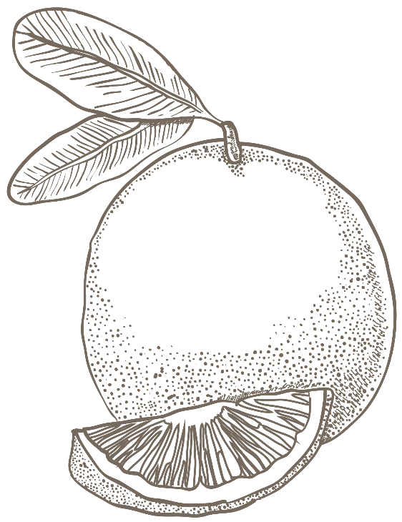
Conclusion
Integration of deep learning, Bayesian modelling, and Monte Carlo simulations facilitates the creation of an automated aesthetic quality assessment system for Instagram food content, offering reliable insights for content optimization and engagement enhancement.

Slide 9
References
Jeff Donahue, Yangqing Jia, Oriol Vinyals, Judy Hoffman, Ning Zhang, Eric Tzeng, and Trevor Darrell. 2014. DeCAF: A deep convolutional activation feature for generic visual recognition. In Proc. 31st International Conference on Machine Learning. 647--655.
Kazuma Takahashi, Keisuke Doman, Yasutomo Kawanishi, Takatsugu Hirayama, Ichiro Ide, Daisuke Deguchi, and Hiroshi Murase. 2017. Estimation of the Attractiveness of Food Photography Focusing on Main Ingredients.
Li, Z., Zhang, Z. & Gao, S. Classical learning or deep learning: a study on food photo aesthetic assessment.
Sheng, K., Dong, W., Huang, H. et al. Learning to assess visual aesthetics of food images.
Lei Hou, Xue Pan. Aesthetics of hotel photos and its impact on consumer engagement: A computer vision approach
Depth function: https://medium.com/artificialis/getting-started-with-depth-estimation-using-midas-and-python-d0119bfe1159
Engagement rate percentage

Slide 10
Our team
Gargi Rajadnya
Raj Navalakha
Student number: 23200711
Student number: 23205373

Slide 11
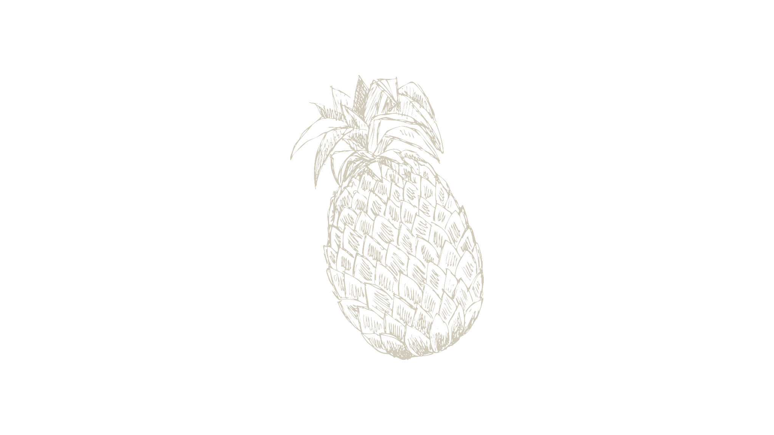


Thanks!

